Slide 1
FEVER Pyrexia of unknown origin

Slide 2
Presenting complaints
7 year old boy – from Kangundo – Informant is the mother
1 month of hotness of the body
2 weeks of Headache, Easy fatigability and Awareness of heart beat.
Last well a month ago when he started experiencing intermittent fever associated with poor swallowing and loss of appetite, poor weight gain and night sweats.
Had a productive cough – thick mucoid sputum, not blood stained, chest pain and one episode of nose bleeding.
Important negatives – no history of difficulty in breathing, stridor, haemoptysis and contact with a person with chronic cough or Rx for TB

Slide 3
Past Medical History
Admitted to Mbagathi 2 months ago and treated for tonsillitis.
2 weeks ago sudden onset frequent headache, global in nature, easy fatigability, general body malaise and awareness of the heart beat. Symptoms aggravated by exertion. No relieving factor.
No history of loss of consciousness, convulsions, visual disturbance or trauma
Seen in Kangundo – HB 4.5g/dL & Platelets 14x10⁹ /dL. Transfused one unit of blood and referred to KNH where he received another unit.
Has developed abdominal pain, discomfort with passage of loose stools and vomiting following the transfusion and which has been managed wit ORS and Zinc sulphate.

Slide 4
Past medical history
ANC/Delivery uneventful
Nutrition – was EBF 6 months, adult diet, sufficient animal source proteins
Growth and development – normal, child in class one and doing well
Immunization – complete –card unavailable, BCG scar seen
Family History – only child of a single mother, lives with the grandmother in Kangudo

Slide 5
How is fever defined?

Slide 6
Definition of fever
Abnormal elevation of body temperature
Rectal temperature >38ºC (100.4ºF)
Non-significant sign
Risk category | Neonates Immunocompromised children | Older children
Significant Temperature Cut-off | > 38ºC | > 38.5ºC - 39ºC

Slide 7
Methods of measurement
Rectal – mercury or digital thermometer
Oral – mercury or digital thermometer
Axillary – mercury, digital or liquid crystal
Forehead – liquid crystal strip
Tympanic – device that measures infra-red (needs co-operation and less accurate in children aged < 3months)
Your own hands – temperature relative to yours
Mother’s report of fever

Slide 8
Recommended Methods of measurement
< 4 weeks old – electronic thermometer in the axillar.
4weeks -5 years - electronic or chemical dot thermometer in the axillar or infra-red Typanic thermometer.
Axillary temperature under-estimates core temperature by 0.5ºC

Slide 9
Regulation of Temperature
Temperature regulated by hypothalamic center.
Temperature rises when the set point is altered by endogenous pyrogens.

Slide 10
Cause of fever
Infections
Malignancies
Autoimmune diseases
Metabolic diseases
Chronic inflammation
Medications including immunization
CNS abnormalities
Exposure to excessive environmental heat

Slide 11
Febrile child
Most febrile children have a brief self-limiting course of illness.
Some infections are adequately identified through clinical examination eg. Tonsillitis or acute otitis media.
Teething does not cause fever
It is important to be able to identify the critically ill child.

Slide 12
Evaluation of the febrile child
Febrile children aged < 3 months with non-specific features of infection often have bacterial infections even when you are unable to grow the organism.
Viral infections are unlikely because they still have maternal antibodies.

Slide 13
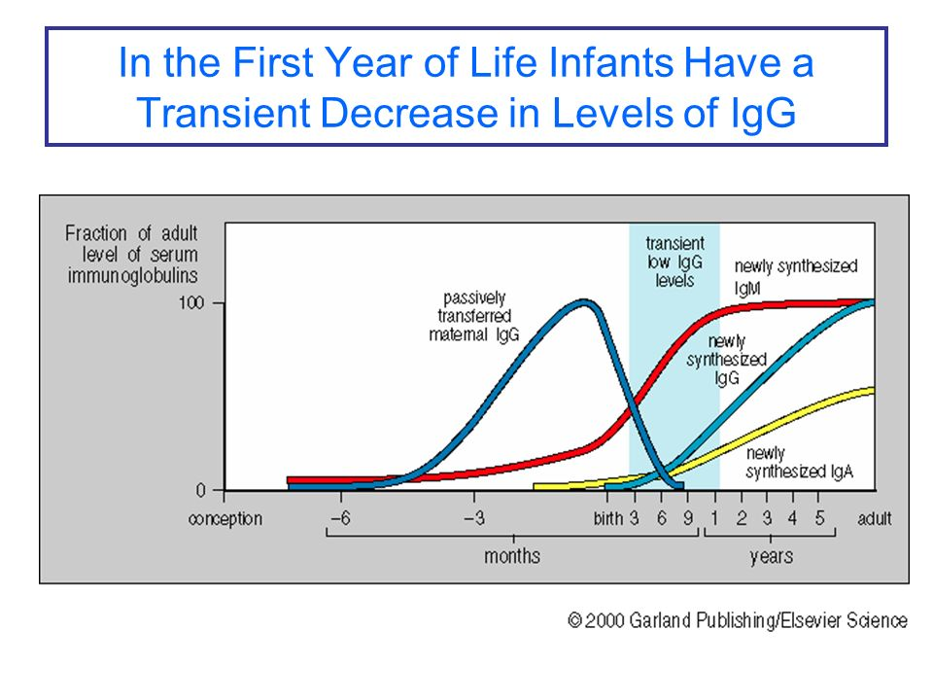

Slide 14
Which child is at risk of infection
Illness in family members
Infection is common in the community – lives in malaria endemic area
Unimmunized child
Recent travel – eg malaria [Present in all areas (including game parks) at altitudes below 2,500 m (8,202ft). including the city of Nairobi.]
Contact with animals (brucelosis)
Immunosuppressed
Sickle Cell Disease (capsulated bacteria)
HIV

Slide 15
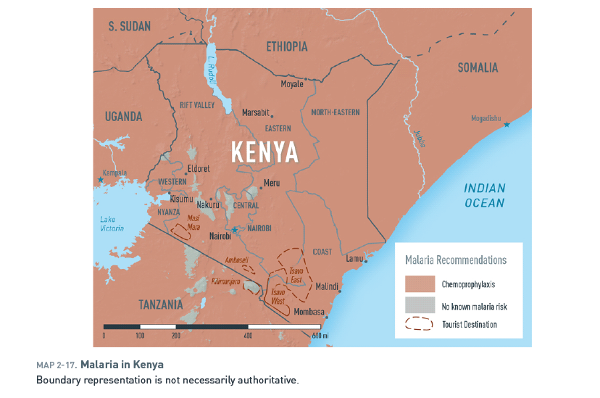

Slide 16
Evaluation of the child with a fever: Take a good history
Duration of fever
How temperature was determined
Maximum height of temperature documented at home
Associated symptoms
Any history of chronic medication
Medication allergies
Fluid intake
Urine out-put
History of travel
Any other symptoms that are a concern to the parent

Slide 17
Evaluation of the child with a fever: Careful physical assessment
Vital signs
Temperature
Heart rate
Respiratory rate
Blood pressure
Oxygen saturation (if child has increased work of breathing)
Complete physical examination including a neurological evaluation
Does the child look toxic
What is the hydration status

Slide 18
Septic screen
Blood culture
Full Blood Count
Acute phase reactants (CRP, ESR)
Urine sample
Consider if indicatesd
CXR
LP – CSF…. C/S, Gram stain /biochemistry,
Rapid antigen tests
pneumococci
PCR – CSF diagnosis of Herpes Simplex Virus infection

Slide 19
Features of severely ill child
Fever > 38ºC if < 3 months or > 39ºC in 3-6 month
Colour – pale, mottling
Altered consciousness, Bulging fontanel, Seizures, Focal neurological signs
Significant respiratory distress
Bile stained vomitus
Severe dehydration or shock

Slide 20
Who should receive home management of fever
Well appearing
Well hydrated
Clear evidence of routine viral infection –eg common cold
Give symptomatic treatment with instructions on what should trigger return visit for further evaluation.
Many children with bacterial infection can also be treated at home with antibiotics depending on their clinical status.

Slide 21
Child with fever – who should be seen immediately
Child aged < 3 months with fever of > 38ºC
All children with fever is > 40.6ºC
child is crying inconsolably or whimpering
child is crying when touched or moved
child is difficult to awaken
Child’s neck is stiff
Purple dots or spots are present on the skin

Slide 22
Child with fever – who should be seen immediately
Difficulty in breathing not improved by clearing nasal passages
Has had a seizure
Immunologically vulnerable child
sickle cell disease,
splenectomy,
HIV,
Cancer chemotherapy,
organ transplant or
chronic steroid therapy
Child acts or looks very sick.

Slide 23
Fever in neutropenic patient
One hundred and thirty episodes of febrile neutropenia were identified in 104 patients.
The mean patient age was 19, and 53% of the patients were male.
Approximately 86% of the episodes occurred in patients with haematological disorders.
An infectious site was identified in 65% of patients;
41% of the febrile neutropenia patients exhibited a localized infectious focus
24% developed bloodstream infections, respectively.
The majority of infections were found in blood, urine, gastrointestinal tract, and soft tissue.
Febrile neutropenia in the tropics: a description of clinical and microbiological findings and their impact on inappropriate therapy currently used at an oncological reference center in Colombia. Cortés JA, Cuervo S, Gómez CA, Bermúdez D, Martínez T, Arroyo P.
Biomedica. 2013 Jan-Mar;33(1):70-7. doi: 10.1590/S0120-41572013000100009

Slide 24
Fever in neutropenic patient
The majority of infections were found in blood, urine, gastrointestinal tract, and soft tissue.
microbiological isolates revealed
46.4% Gram-negative bacilli,
38.4% Gram-positive cocci,
8% fungi, and
7.1% parasites;
there was a 7.7% mortality rate.
Appropriate empirical antimicrobial therapy was a protection-related factor in multivariate analyses (OR= 0.17; 0.034 – 0.9 95% CI; p= 0.037).
Febrile neutropenia in the tropics: a description of clinical and microbiological findings and their impact on inappropriate therapy currently used at an oncological reference center in Colombia. Cortés JA, Cuervo S, Gómez CA, Bermúdez D, Martínez T, Arroyo P.
Biomedica. 2013 Jan-Mar;33(1):70-7. doi: 10.1590/S0120-41572013000100009

Slide 25
Review within 24 hours
A 3-6 month old baby – unless fever occurs within 48 hours of the DPT and infant has no other symptom.
Fever exceeds 40ºC (especially if the child is < 3 years)
Burning or pain during urination
Fever is present for > 24 hours without an obvious cause or site of infection.
Fever subsided fro > 24 hours and then recurred.
Fever present for > 72 hours.

Slide 26
Fever without a focus of infection
Diagnostic challenge
Consider serious hidden or occult bacterial infections.
Common cause of occult bacterial infections are Haemophilus influenzae type b and Streptococcal Pneumoniae.
Commonest cause of invasive bacterial infections.
Incidence has declined with use of the HiB and pneumococcal vaccination
Vaccines are not perfect and therefore should be considered first.
Other bacteria may cause occult infections

Slide 27
Mortality from invasive Pneumococcal Disease of HIV infected, exposed and unexposed infants
P=0.07
Mollendorf C et al. CID 2015;60(9):1346-56.

Slide 28
Febrile child aged < 28 days
High risk for serious infection including sepsis.
Manage conservatively
Admit
Parenteral antibiotics strongly recommended in all circumstances
Evaluation
complete blood count and PBF
Blood culture
Urine – urinalysis and culture
CSF – gram stain, biochemistry and culture and sensitivity
Consider neonatal herpes infection
CXR if there is increased work of breathing

Slide 29
Fever without focus in child aged 29-60 days: Children are at risk for various bacterial infections
Toxic Looking
Non-toxic
admit to hospital for parenteral antibiotics and close observation.
Malaria in post 6 months children
Viral respiratory infections are common (URTI, Bronchiolitis – may not need further work-up)
Urinary tract infections are common in this age group
Further classify
Low risk for invasive bacterial infection
High risk for invasive bacterial infections

Slide 30
Fever without focus in child aged 29-60 days: Children at low risk for various bacterial infections
Previously healthy
No focal infection on examination
WBC 5000-15,000/mm³
Bands are < 1500/mm³
Normal urinalysis
Diarrhoeal stool
- < 5 WBC/High power field
Negative gram stain
Manage as an out-patient

Slide 31
Investigations
With current pneumococcal vaccination program – difficult to estimate the prevalence of occult S Pneumoccal bacteremia or even the sero-types causing illness.
Children aged 3-36 months - any child with fever > 39ºC
Urine culture all males < 6 months and all girls < 2 years
CXR in any child with increased work of breathing or has high WBC (> 20,000 cells/mm³) and no focus of infection.

Slide 32
Management
Empiric antibiotics if;
Temperature > 39ºC
WBC > 15,000 cells/mm³
Consider deferring antibiotics and observing if
Healthy looking
Fully immunized
Reassuring laboratory results
Able to come back promptly if there is a change in status

Slide 33
Treatment
Reassure parents that fever < 41.7ºC does not cause brain damage.
Fever may occasionally cause seizures. – and febrile seizures are generally harmless.
Acetaminophen – paracetamol indicated in children aged > 2 months with fever of 39ºC or are uncomfortable 15mg/Kg body weight every 4-6 hours.
Ibuprofen 10mg/Kg every 6-8 hours.
Aspirin should not be given because of risk of Reye’s syndrome

